Slide 1
The Internal Operating System
Last Time
Major Ideas and Concepts
Operating System Internals
Processes and Threads
CPU Scheduling
Memory Management
Virtual Storage
Virtual Machine

Slide 2
Last Time
The features and strengths of the various types of user interfaces
The tradeoffs among interfaces
The nature of the different types of tasks and services that are performed within a user interface
The purpose and design of command languages and shell scripts
The purpose for the job control language or JCL
The services that are provided to a user's programs
The concept of an application programming interface

Slide 3
Major Ideas and Concepts
The concept of processes and threads; process and thread creation, process management
Techniques used for scheduling and dispatching processes and threads
Memory management techniques; memory partitioning, the concept of overlays
The role of the operating system in the operation and management of virtual storage
Networking OS services, protocol stacks, sockets, remote procedure calls
The concept of deadlock
The concept of a virtual machine

Slide 4
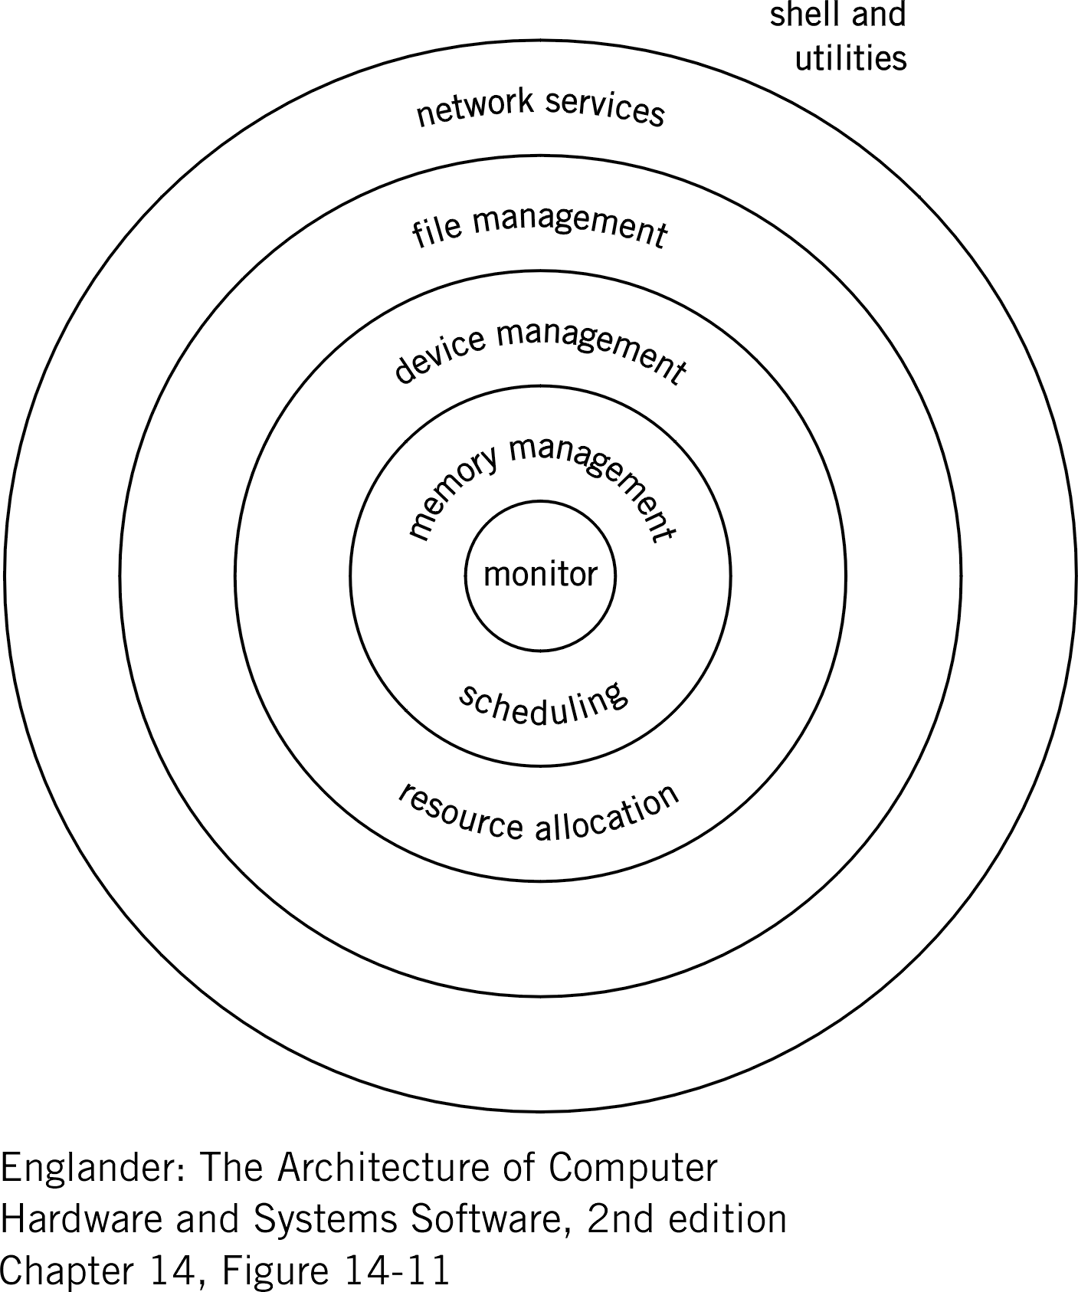
Operating System Internals
User requests
Layers inter-communicate
Provides transmission protocols and data transmission formats
Logical file requests are translated to physical I/O requests.
Device and program conflicts are resolved here.
Determines if it’s possible to load programs or data.
Provides overall control, manages conflicts and handles errors
Operating System Model

Slide 5
Processes and Threads
Processes
A process is a computer program, along with all the computing resources it consumes as long as it is in the state of execution
State of execution - the program is initially loaded into memory for the execution of its first instruction and continues to remain active i.e. still residing in memory
Another way to view a process is to think of it as a program during the course of its execution
In a multi-user system, users may be sharing the same application program
One copy of the program is actually loaded into memory and each user shares the program code or instructions

Slide 6
Processes and Threads
Processes
For the operating system to keep things straight so that user data and results don’t get commingled, each user is given its own memory area for saving their specific results and status data
Hundreds of users can share a single copy of a program but each users work is kept as separate processes
Creates the illusion that each user has their own copy or the program
To keep track of the requested processes, the operating system creates and maintains a Process Control Block or PCB for each process

Slide 7
Processes and Threads
Threads
Think of a thread as a mini-process
If a process is a unit of work, then a thread is a smaller unit of work under the control of a process
By using threads a process can achieve a higher level of performance by creating many smaller units of work that can be executed in concurrently
Threads are managed by the process so that the operating system can get more work done

Slide 8
Processes and Threads
Threads
Don’t have the overhead of a Process Control Block for each thread
Threads don’t require the operating system to manage memory, files, or deal with inter-thread synchronization
Threads are commonly used by event-driven programs where there is no single program flow, just many different unrelated logic flows design to handle a variety of different events
Operating system or database management system software are classic examples of where you might find many threads being used

Slide 9
CPU Scheduling
In multi-user environments, operating systems needs a way to give each process an increment, or slice, of the CPU resource
CPU scheduling is a means for optimizing of the computer’s resources
Allows multiple processes to execute concurrently
CPU scheduling consists of two distinct components:
  Long-term scheduler - manages the input of processes into the mix and is responsible for admitting them to the system
  Dispatcher - maintains the mix by providing short-term scheduling, i.e. instant-by-instant allocation of CPU for processes needing more CPU resources
Algorithms determine when a process should be suspended and a new one put in its memory space
This operation is known as swapping

Slide 10
Memory Management
Memory management is a way for assigning memory resources
Processes and data have the appropriate amount of memory for adequate loading and execution
Multi-user systems - each user’s processes need memory resources to be allocated equability
Memory is the first resource required before a process can be executed
Strong correlation between the scheduling and memory management functions

Slide 11
Memory Management
Amount of available memory limits the number of processes that can be scheduled and dispatched
Think of it this way, if there is only enough memory for one process, then a multi-user system effectively becomes a single-tasking system
As a general rule the more processes that can be executed concurrently the better the overall computer system throughput – effectively the computer is doing more work during a given time interval
However, any one task or process may actually take longer in duration to complete then if it were executing in the system by itself

Slide 12
Virtual Storage
In a multi-user system, an operating system creates an illusion that it has more “real” memory than is actually exists
Real memory is the amount of hardware memory contained on the memory cards plugged onto the motherboard
A computer with 384 megabytes of memory has approximately 384,000,000 eight-bit bytes for the operating system to manage
With proper memory management using a technique called “paging”, the operating system can create what is called virtual memory
Moves infrequently used processes (called pages) to disk and put in its real memory place a new process
Creates an illusion that there is more memory than is really available
As processes become inactive, waiting for other resources such as I/O, the pages that were swapped to disk are brought back into real memory to be executed
To the user, it looks as though the system is capable of processing many more programs concurrently than there is real memory available to support them

Slide 13
Virtual Machine
Some operating systems have the capability to create the illusion that a single computer looks to the user as if it were multiple computers, each with its own unique operating system
Operating systems with this capability are called “virtual machines”
Provides the capability to run multiple operating systems as “guests” under the control of the “virtual machine”
An example of this is IBM’s z/VM operating system
Under z/VM, a mainframe, can run under VM a variety of different guest operating systems like Linux, MVS or z/OS
Guest operating systems are tricked into believing that they have access to all the hardware resources: CPU, registers, memory and I/O
Each guest behaves as a separate machine; but in reality they are interfacing with VM on a single machine
Downside - additional overhead to support the guest operating systems

Slide 14
Next Time
File Management

